Slide 1

Vel Tech Rangarajan Dr. Sagunthala R&D Institute of Science and Technology
School of Computing
Department of Computer Science and Engineering
10211CS224 / FULL STACK APPLICATION DEVELOPMENT (JAVA)
PROJECT REVIEW : MILESTONE PROJECT – 1
Date: 25-03-2026
Academic Campus Event & Registration Portal
SDG: SDG No – 4 – Quality Education (Promoting Effective management of education events)
Courses Handling Faculty:
Dr. S.HEMAMALINI,M.E.,Ph.D.,
Assistant Professor (Senior grade)
Presented By:
VAMSI TRINADH DIRSIMILLI – VTU25924– 23UECS1053

Slide 2
INTRODUCTION
1
The Academic Campus Event & Registration Portal is a web-based platform developed to simplify the management and registration of campus events. It provides a centralized system where students can easily view upcoming academic, technical, sports, and cultural events organized within the campus. Through this portal, students can register for events by entering details such as their name, student ID, department, and contact information. The system helps event organizers efficiently manage participant data and track registrations. By replacing manual registration methods, the portal saves time, reduces paperwork, and improves accuracy. It also enhances communication between students and event coordinators, ensuring that information about events reaches students quickly. Overall, the portal promotes better participation and engagement in campus activities while making the event management process more organized and efficient.
2
3
4
5
6
7
8
9

Slide 3
PROBLEM STATEMENT
In many colleges, event registration and management are still handled manually through paper forms, emails, or scattered online tools. This manual process often leads to errors, loss of data, and difficulty in maintaining participant records. Event organizers face challenges in collecting registrations, verifying student details, and tracking the number of participants. Students may also miss event information due to the absence of a centralized platform. Managing updates, schedules, and participant lists becomes time-consuming and inefficient. There is a need for a reliable digital system where students can easily view available events and register online. The system should securely store student details and event information in a structured database. Implementing an automated event registration portal will improve efficiency, reduce manual work, and provide better management of campus events.
1
2
3
4
5
6
7
8
9

Slide 4
OBJECTIVE(S)
1
2
To design and develop a scalable and user-friendly web-based Academic Campus Event Registration Portal using modern web technologies, enabling students to view event details, register online, and access event-related updates efficiently.
To implement a centralized database-driven system that manages event information and student registration data, providing secure data storage, easy retrieval, and efficient event management for organizers.
3
4
5
6
7
8
9

Slide 5
PROPOSED SYSTEM
The system provides a web-based platform where students can view available campus events and register online easily.
It stores student and event details in a centralized database for efficient management and quick access.
Event organizers can create, update, and manage events through the portal.
The system allows students to register for events without manual forms, reducing paperwork.
It provides accurate participant records, minimizing errors and duplicate registrations
Organizers can track the number of registered participants and manage event participation effectively
The portal ensures secure storage and easy retrieval of event and student data
Overall, the system improves efficiency, reduces manual work, and simplifies campus event management.
1
2
3
4
5
6
7
8
9

Slide 6
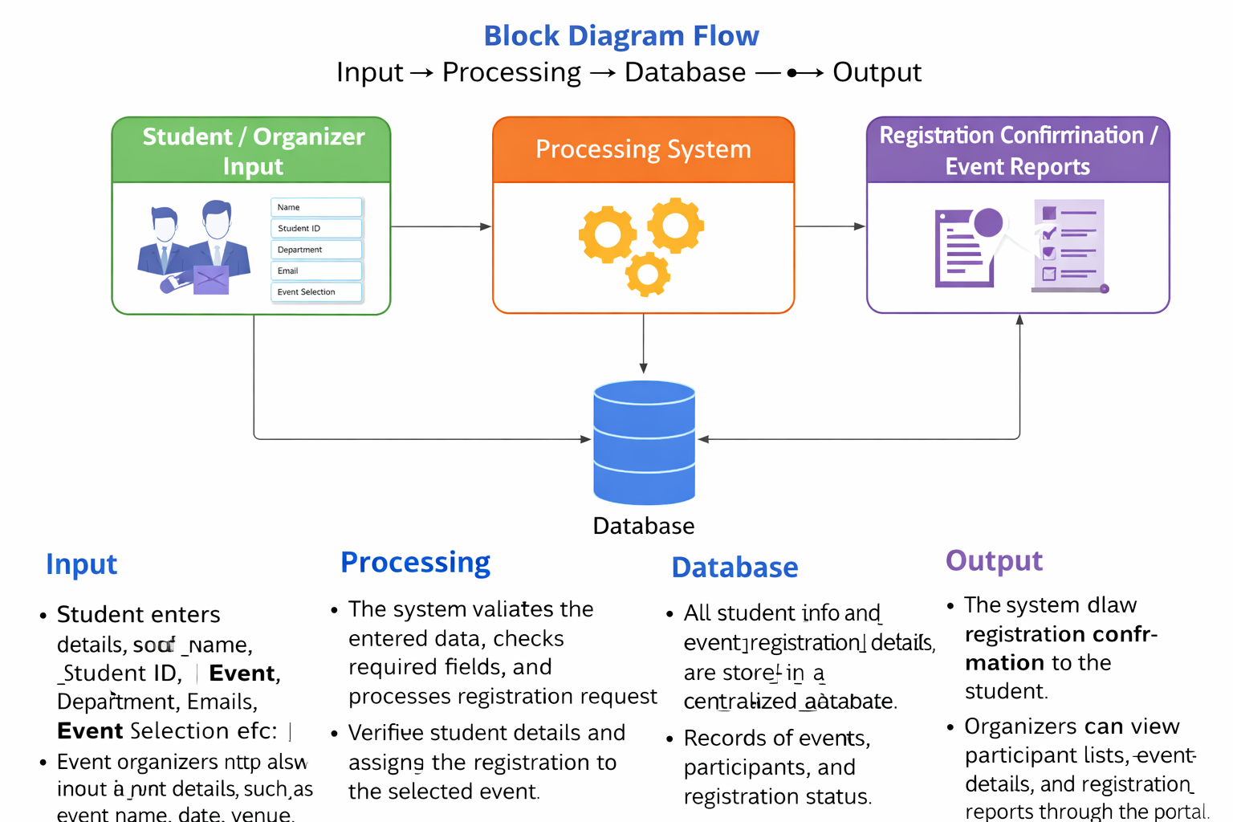
PROPOSED SYSTEM ARCHITECTURE
1
2
3
4
5
6
7
8
9

Slide 7
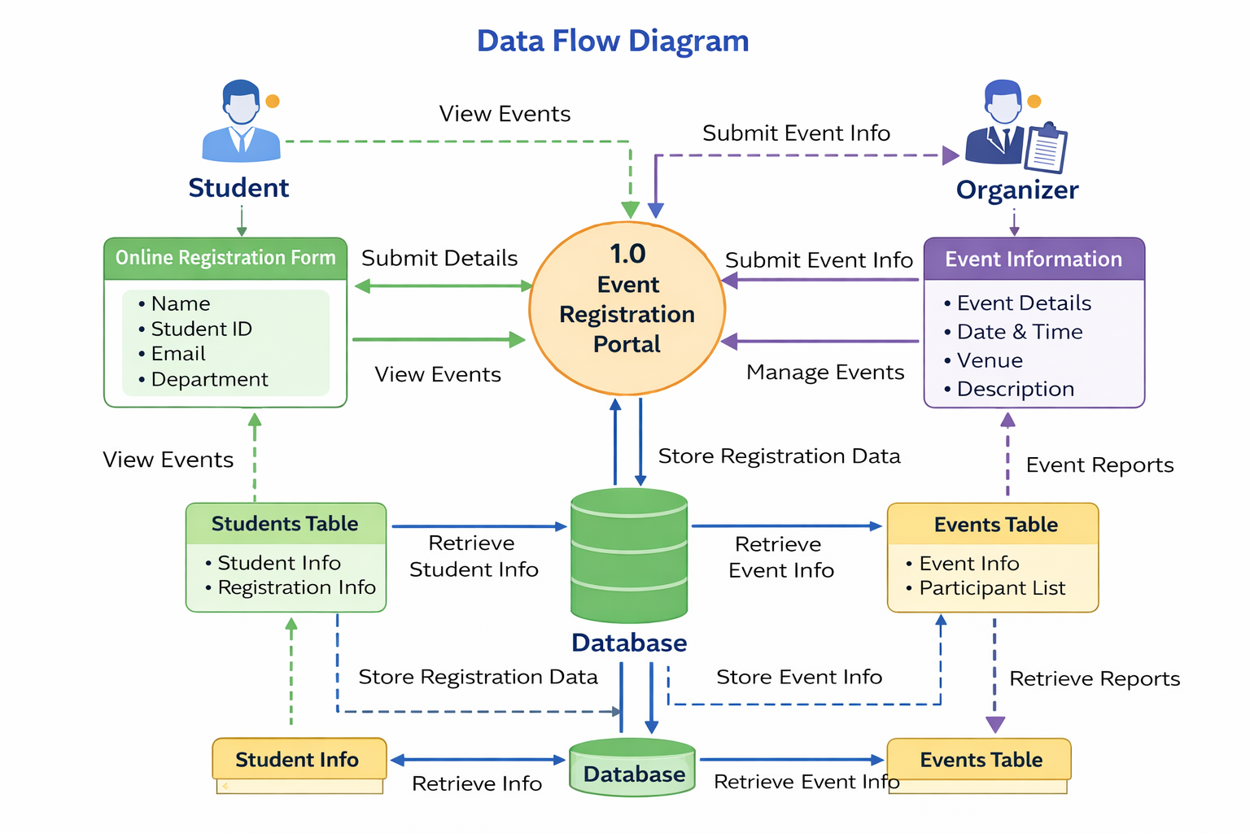
WORKFLOW
1
2
3
4
5
6
7
8
9

Slide 8
TECHNOLOGIES USED
Frontend:
HTML5 – Used to design the structure of the event registration portal.
CSS3 – Used for styling, layout, and responsive design of the web interface.
JavaScript – Used to connect the frontend form with Firebase and handle form submission.
Backend:
Firebase Services – Used as a backend platform to manage authentication, database storage, and real-time data handling without a traditional server.
Database:
Firebase Realtime Database / Cloud Firestore – Used to store student registration details such as:
Name
Student ID
Email
Department
Selected Event
Tools Used:
Visual Studio Code (VS Code) – For writing and editing code.
Firebase Console – For managing the database and project settings.
Web Browser (Chrome / Edge) – For testing the web application.
1
2
3
4
5
6
7
8
9

Slide 9
MODULE DESCRIPTION
Module 1: Student Registration
Allows students to enter details such as name, student ID, email, department, and selected event through the online registration form.
Module 2: Event Management
Displays available campus events such as technical, cultural, sports, and academic events, allowing students to view details and choose events for participation.
Module 3: Database Management
Stores and manages student registration data and event information using the Firebase database, ensuring secure and organized data storage.
Module 4: Registration Confirmation & Management
Processes the registration request and provides confirmation of successful event registration, while allowing organizers to view participant details.
1
2
3
4
5
6
7
8
9

Slide 10
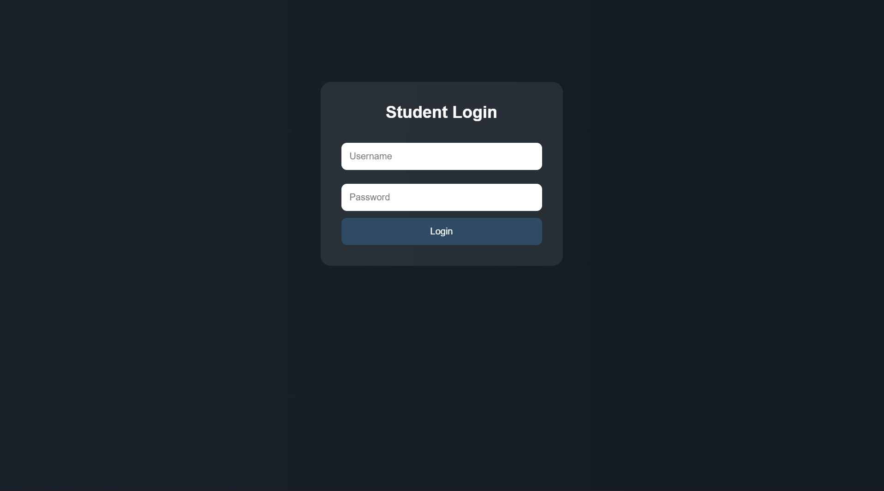
IMPLEMENTATION SCREENSHOTS
Login page:
1
2
3
4
5
6
7
8
9

Slide 11
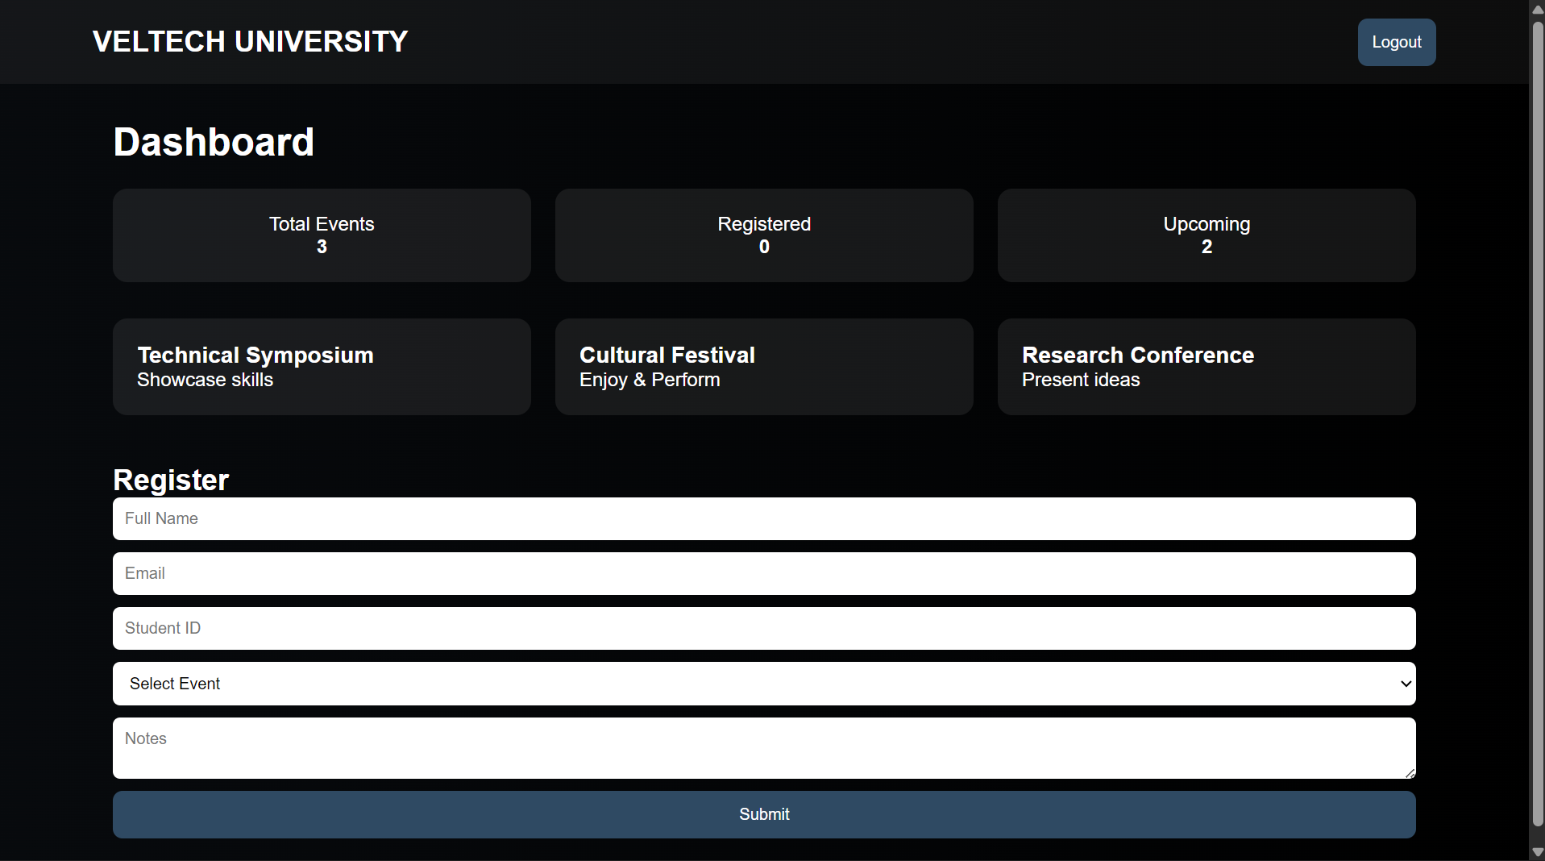
IMPLEMENTATION SCREENSHOTS
Home Page:
1
2
3
4
5
6
7
8(A)
9

Slide 12
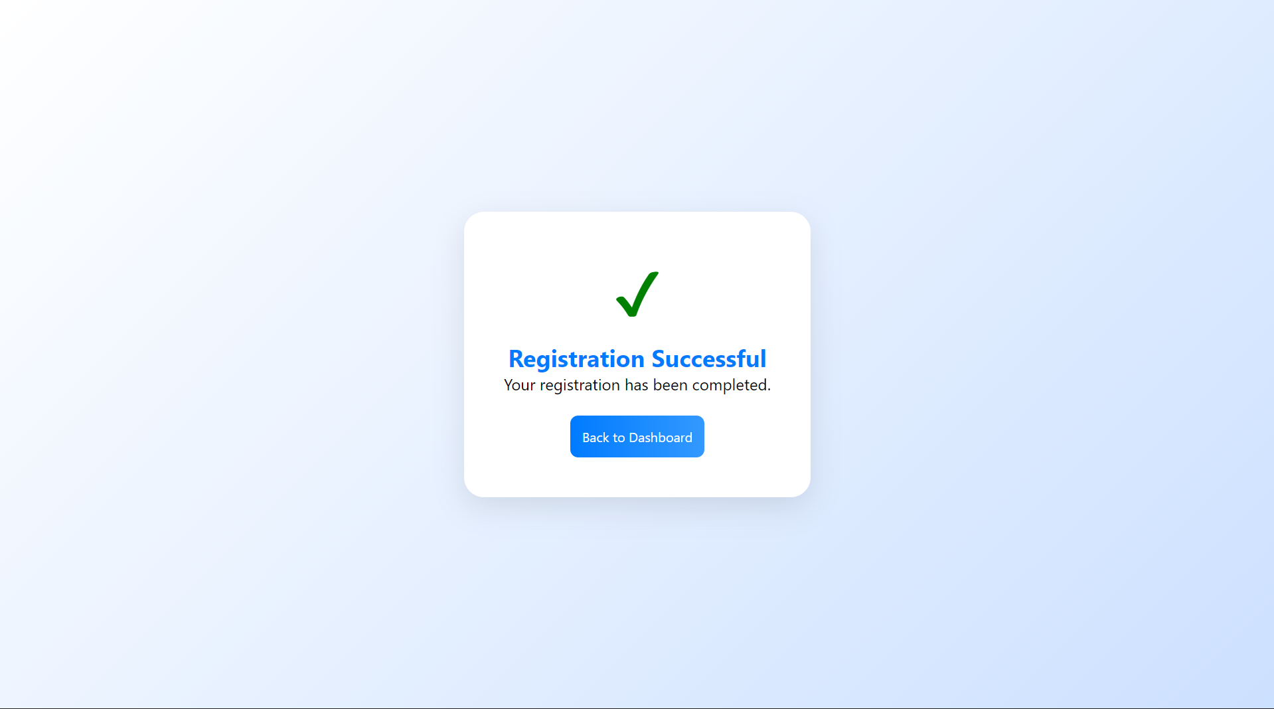
IMPLEMENTATION SCREENSHOTS
Registered Page :
1
2
3
4
5
6
7
8(B)
9

Slide 13
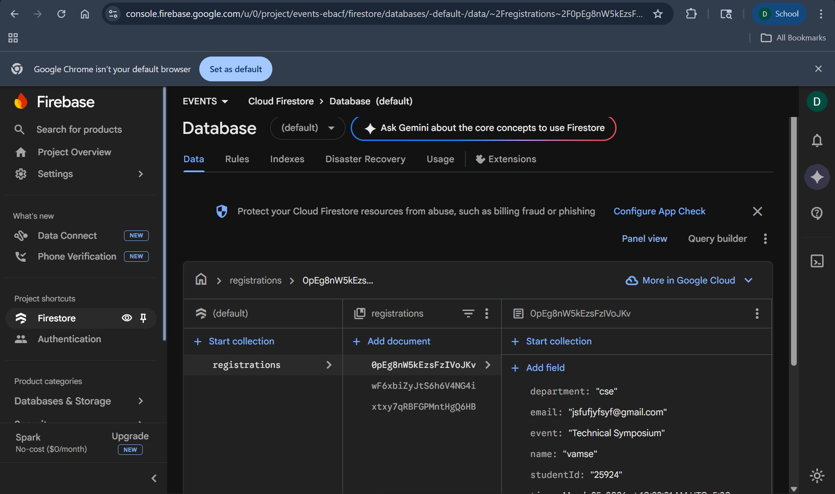
Firebase ScreenShot
IMPLEMENTATION SCREENSHOTS

Slide 14
ADVANTAGES & LIMITATIONS
1
Advantages:
Easy online registration – Students can register for events quickly through the web portal.
Centralized data management – All event and student details are stored in one database.
Reduces manual work – Eliminates paper forms and manual data entry.
Faster event management – Organizers can easily track participant registrations.
Accurate data storage – Reduces errors and duplicate registrations.
Easy access to event information – Students can view event details anytime.
Limitations:
Internet dependency – The system requires an internet connection to access the portal.
Basic security limitations – Without advanced authentication, data security may be limited.
Limited functionality – The system mainly focuses on registration and may not include advanced event management features.
User dependency – Incorrect data entry by students may lead to inaccurate records.
2
3
4
5
6
7
8
9

Slide 15
Thank you

